Slide 1






WISE: Low-Cost Wide Band Spectrum Sensing Using UWB
Zhicheng Luo^{1,3}, Qianyi Huang^{2,3}, Rui Wang¹, Hao Chen³, Xiaofeng Tao^{4,3}, Guihai Chen⁵, Qian Zhang⁶
Southern University of Science and Technology¹, Sun Yat-sen University²,
Peng Cheng Laboratory³, Beijing University of Posts and Telecommunications⁴,
Shanghai Jiao Tong University⁵, Hong Kong University of Science and Technology⁶
Notes:
Hello everyone, I am Zhicheng. Today I will introduce our work: WISE low-cost wide band spectrum sensing using UWB.

Slide 2






Shortage of Spectrum Resource
Billion
36.4
The number of wireless devices is growing rapidly
26.4
4.7
Conventional Spectrum Access
2017
2022
2027
Year
Spectrum
Access
......
Spectrum shortage is coming
Notes:
Now, the number of wireless devices is growing rapidly and \ thus resulting in a shortage of spectrum resources.

Slide 3


Dynamic Spectrum Access (DSA)
Spectrum
Access
Access
Spectrum sensing
Primary users
Secondary users
City-level wideband (150MHz ~ 1GHz) spectrum sensor is in need
Notes:
The FCC has proposed Dynamic Spectrum Access (DSA), which \ allows primary users and secondary users to share the same spectrum band. The \ secondary users can use the spectrum band when the primary users are idle. The key point for the success of DSA \ is the wideband spectrum sensing capability.

Slide 4
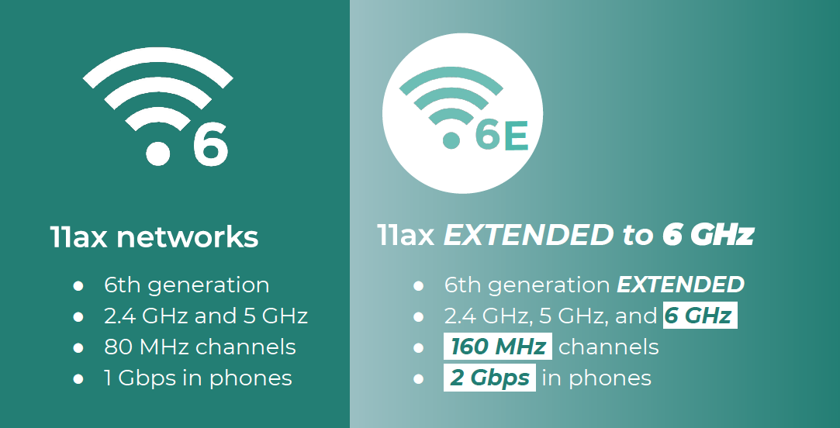


Unlicensed Bands
CBRS band,
150MHz (From 3.55GHz to 3.70GHz)
Unlicensed 6GHz band
1.2GHz (From5.925 GHz to 7.125GHz)
City-level wideband (150MHz ~ 1GHz) spectrum sensor is in need
Notes:
FCC has released 150MHz and 1.2GHz unlicensed spectrum for dynamic spectrum access in 3.5GHz and 6GHz, respectively. / Thus, a low-cost wideband spectrum sensor is in need.

Slide 5
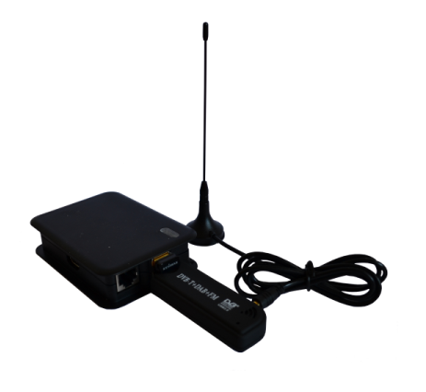
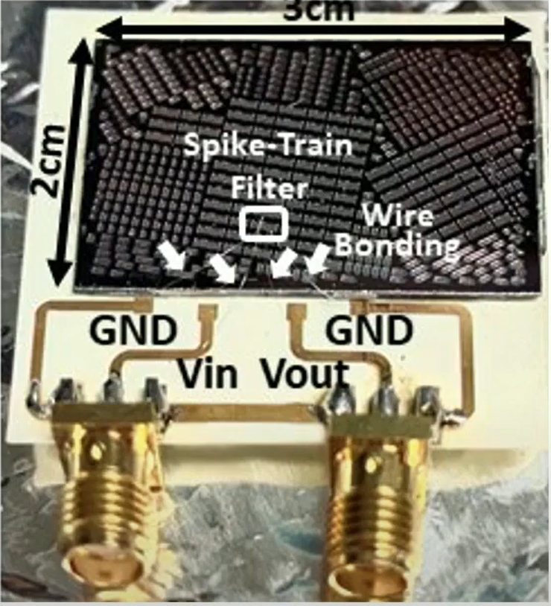
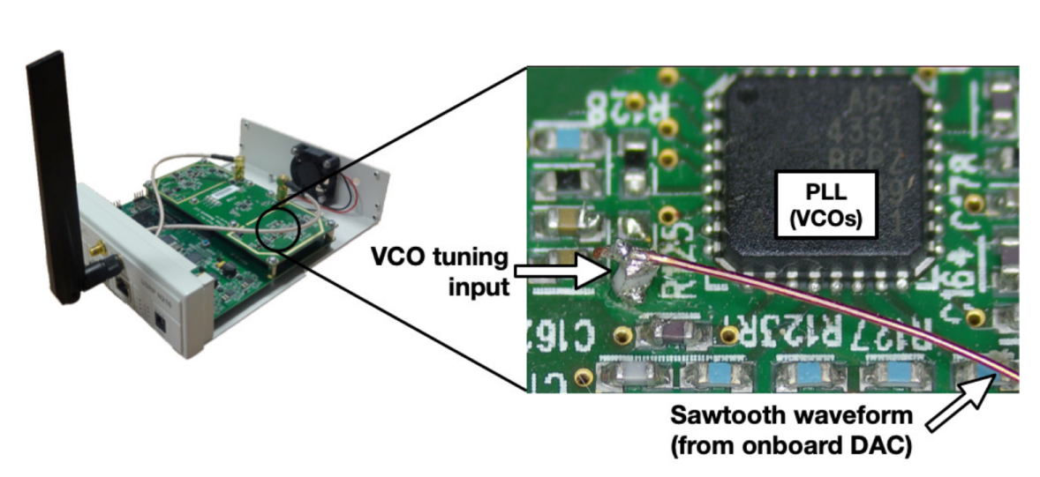
Wideband Spectrum Sensing
RTL-Dongle
S³
SweepSense
Low time resolution
Not ready for large scale deployment
Notes:
However, although there is some existing works on wideband spectrum sensing, the prior work has some limitations \ such as low time resolution or \ not ready for large scale deployment.

Slide 6
Can we enable wideband spectrum monitoring with low-cost, commercial off-the-shelf devices?
WISE：Low-Cost Wide Band Spectrum Sensing Using UWB
Notes:
So, we ask the question that, can we enable wideband spectrum monitoring with low-cost, commercial off-the-shelf devices? \ In this work, we design WISE, a Low-cost wide band spectrum sensor using UWB.

Slide 7
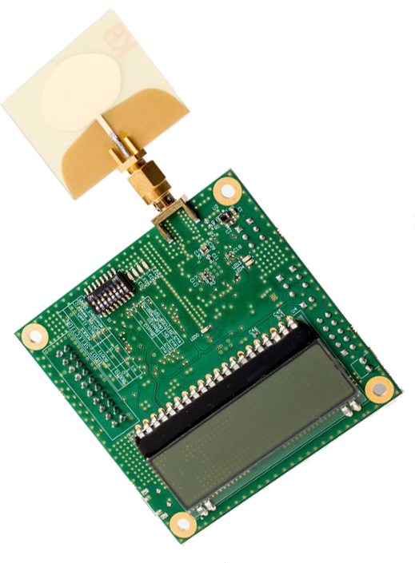
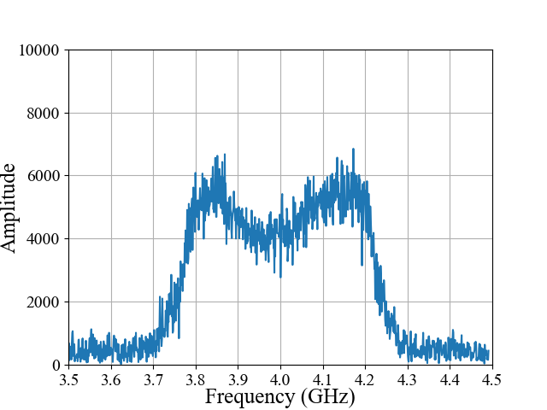
Feasibility of Spectrum Sensing
Data
PHR
Preamble p(t)
p(t)*h(t)
h(t)
Correlation
h(t)(CIR)
Preamble p(t)
FFT
H(f)(CFR)
Notes:
In UWB communications, the transmitter will \ transmit a known preamble signal to the receiver, who \ will correlate the received signal with the preamble signal and \ calculate the channel impulse response (CIR). \ After FFT operation, we will get the channel frequency response (CFR). We define it as H(f)

Slide 8
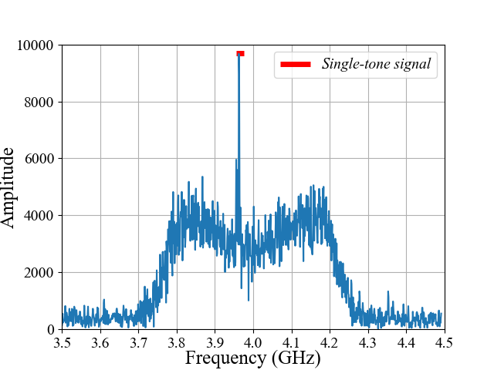
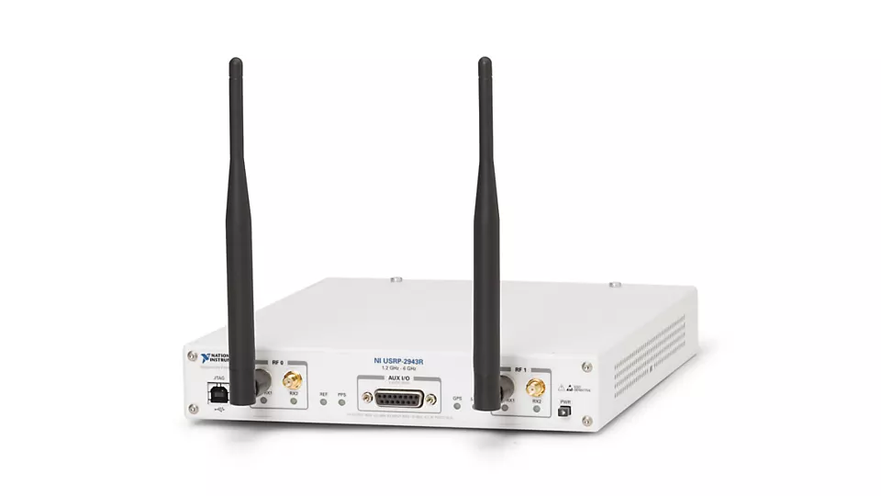
Feasibility of Spectrum Sensing
(p(t)+x(t))*h(t)
Data
PHR
Preamble p(t)
p(t)*h(t)
h(t)
Correlation
h(t)+p(t)*x(t)
h(t)(CIR)
Preamble p(t)
FFT
H(f)+P(f)X(f)
H(f)(CFR)
Single-tone signal x(t)
Notes:
When there is another signal in the air, the receiver will \ also receive it, correlate \ it with the preamble and \ calculate the CFR.

Slide 9
Feasibility of Spectrum Sensing
Data
PHR
Preamble p(t)
(p(t)+x(t))*h(t)
h(t)
Correlation
h(t)+p(t)*x(t)
Preamble p(t)
FFT
H(f)+P(f)X(f)
Single-tone signal x(t)
Notes:
And~

Slide 10
Feasibility of Spectrum Sensing

Slide 11
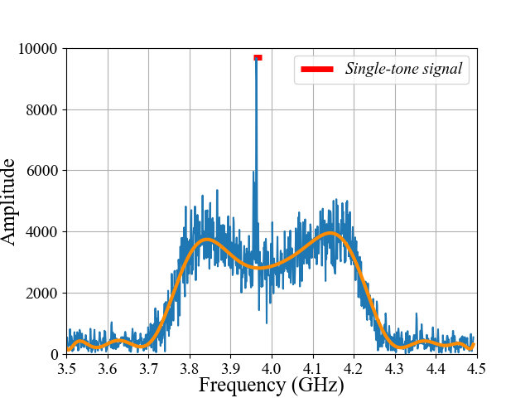
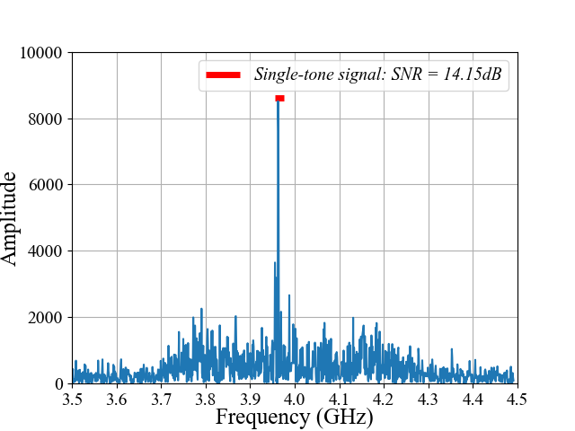
Feasibility of Spectrum Sensing
H’(f)=P(f)X(f)
H’(f)=H(f)+P(f)X(f)
P(f)X(f)
H(f)
900MHz
Notes:
In this CFR, it has both the external in-air signal response X(f) and internal response H(f). \ So, if we can remove the H(f) from the CFR, we can get the spectrum information of in-air signal. \ As the UWB has a maximum receiving bandwidth of 900MHz, we can sense up to 900MHz bandwidth in one detection.

Slide 12
Challenges
How to extract the in-air signals
Unknown AGC factor
Non-predictable signal power
How to extract the in-air signals
How to address the nature limitations of low-cost devices
Low SPI speed
Low spectral resolution
Notes:
Although it sounds straightforward, we face two challenges. The first challenge is how to extract the in-air signal and the second challenge is how to address the nature limitations of low-cost devices. \ For the first challenge,

Slide 13
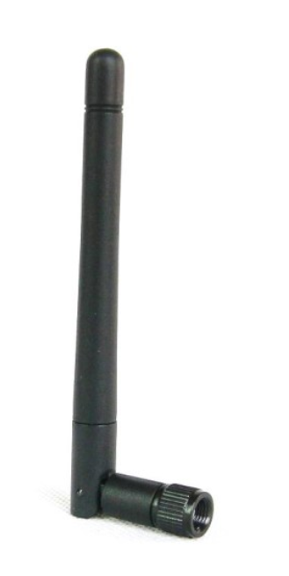

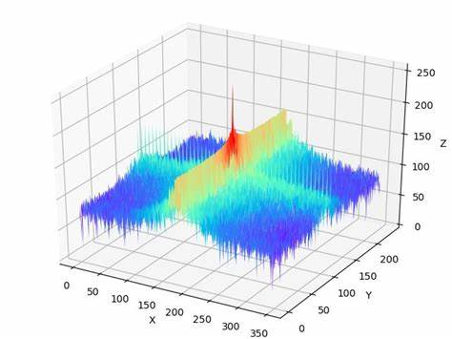
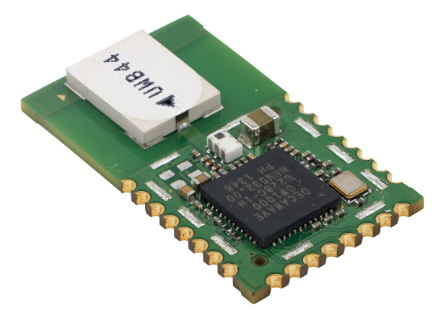
Extract the In-air Signals - Wired Connection
Sensing antenna
Receiving block
✔
In-air signal source
CFR
✔
Controller
Preamble p(t)
Excitation block
H’(f)=H(f)+P(f) ⋅X(f)
H’(f)=H(f)+P(f) ⋅X(f)
Constants
Notes:
In System design, we use a \ sensing antenna to receive the external in-air signal, and use a wire\ to connect the UWB transmitter and \ receivers. The UWB transmitter will \ transmit a preamble as a trigger for measurement. The UWB receivers \ will calculate the CFR only when the preamble has been detected. \ In the wired connection, the H(f) and P(f) could be assumed as Constants.

Slide 14
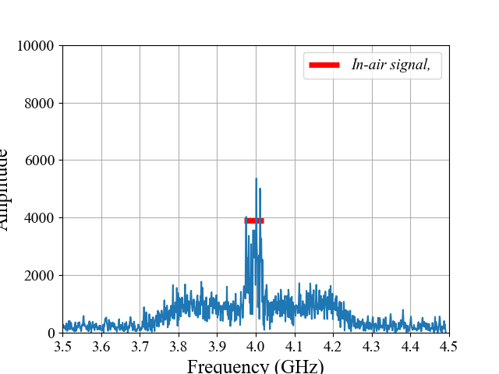
H’₁(f)
Extract the In-air Signals - AGC
H(f)
H’₂(f)
Notes:
when we know the H(f), can we directly remove H(f) to calculate the in-air signal? the answer is no, For example, we \ have captured two in-air signals, the CFR is H1(f) and H2(f)。

Slide 15
H’₁(f)
Extract the In-air Signals - AGC
H(f)
H(f)
H’₂(f)
H(f)
Notes:
If we directly remove the H(f), the SNR will be too low to detect the in-air signal

Slide 16
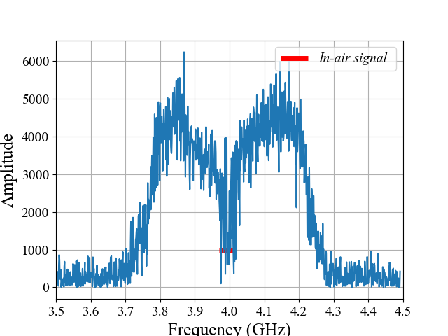
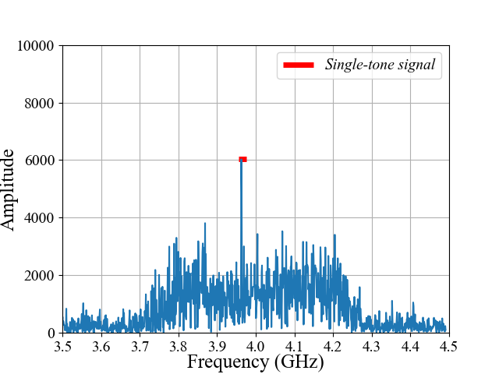
H’₁(f)
X₁(f)
Extract the In-air Signals - AGC
H(f)
X₁(f)=H’(f)-H(f)
H(f)
X₂(f)
H’₂(f)
X₂(f)=H’(f)-H(f)
H(f)
SNR is too low
Notes:
If we directly remove the H(f), the SNR will be too low to detect the in-air signal

Slide 17
H’₁(f)
Extract the In-air Signals - AGC
H(f)
X₁(f)=H’(f)-H(f)
k1⋅H(f)
H’₂(f)
X₂(f)=H’(f)-H(f)
k2⋅H(f)
How to know k1 and k2?
Notes:
This is because the AGC will dynamically adjust the receiver gain to ensure optimal receiver performance. So, we need to figure out the unknown AGC factor before removing H(f)

Slide 18
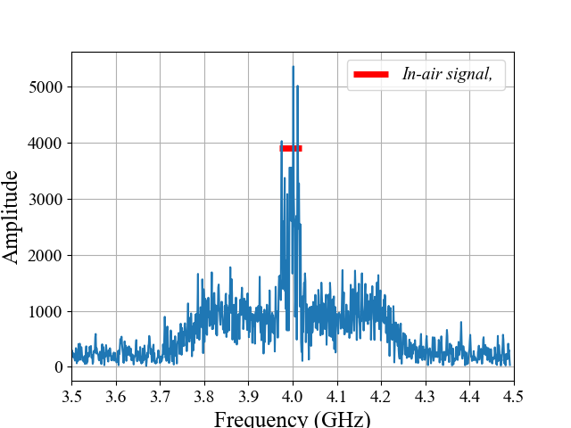
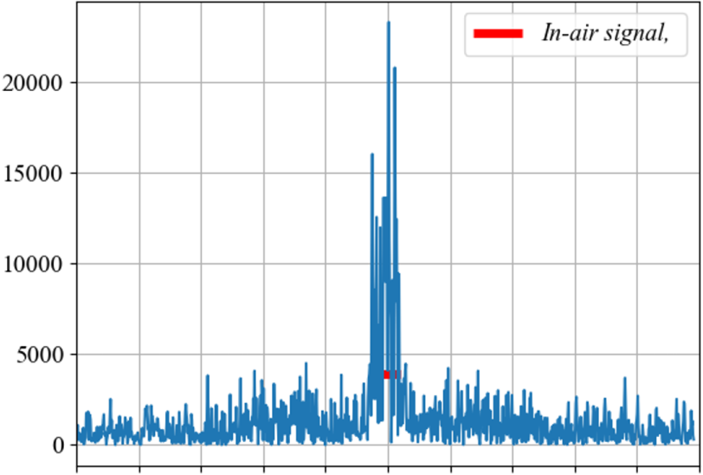
Unknown AGC factor - AGC calibration
Polynomial fitting
--Result: F(f)
AGC factor = F(f)/H(f)
AGC factor = F(f)/H(f)
Spikes
Spikes
F(f)
F(f)
Notes:
To figure out the AGC factor, we observe \ that the X(f) has more spikes in the frequency domain. Thus, we can use a low-degree polynomial(pɑli'noʊmiəl]) \ to fit the more smooth H(f), and \ the fitting result is F(f), we can \ calculate the AGC factor as ratio ([ˈreɪʃioʊ]) of H(f) to F(f), and then \ we can calculate X(f) by removing H(f)

Slide 19
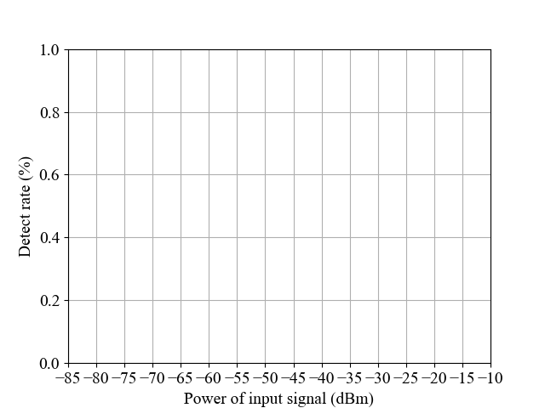
Non-predictable Signal Power
Detect preamble: SNR of preamble = Power of p(t) / Power of x(t)
Detect in-air signal: SNR of in-air signal = Power of x(t) / Power of p(t)
Preamble power:
-56.3dBm/MHz
Low SNR
Fail to detect in-air signal
Low SNR
Fail to detect preamble
Notes:
In every measurement, we \ need to detect\ both the internal preamble and external in-air signal. However, as the \ power of external in-air signal is uncontrollable, when the power of external in-air signal is \ too weak compared with internal preamble, the external signal will be buried by the internal preamble; when it is \ too strong, the receiver will ignore the preamble and will not trigger the CIR estimation.

Slide 20
Non-predictable Signal Power-Dynamic TX power control
-75dBm ~ -25dBm
Preamble power:
-56.3dBm/MHz
State 1
State 2
Preamble power:
-86.3dBm/MHz
Notes:
To have a wide dynamic range, \ WISE has 2 levels of transmit power, and \ switches between those two levels\ according to the power of external in-air signal. Then we could detect signals with \ power from -75dBm to -25 dBm

Slide 21
Challenges
How to extract the in-air signals
Unknown AGC factor
Non-predictable signal power
How to extract the in-air signals
How to address the nature limitations of low-cost devices
How to address the nature limitations of low-cost devices
Low SPI speed
Low spectral resolution
Notes:
For now, we can detect the in-air signal. However, we still need to address the nature limitations of low-cost devices.

Slide 22
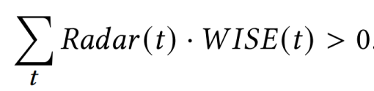
low SPI speed - Radar mode
Radar(t)
Time
1ms
Normal mode
Missing
Sensing (64us)
Reading 1016 CIR points (2ms)
Radar mode
Detection
Time interval: δ
Reading 150 CIR points (500us)
Notes:
The low-speed SPI interface will \ take about 2ms to fetch the complete CIR. This will \ lead to missing some fleeting signal like radar during the data communication time. In order to reduce the data communication time, instead of getting the complete CIR, each time \ we fetch only a portion of CIR, and design an inter-packet time interval to make sure WISE can capture at least one radar pulse in its sensing period.

Slide 23
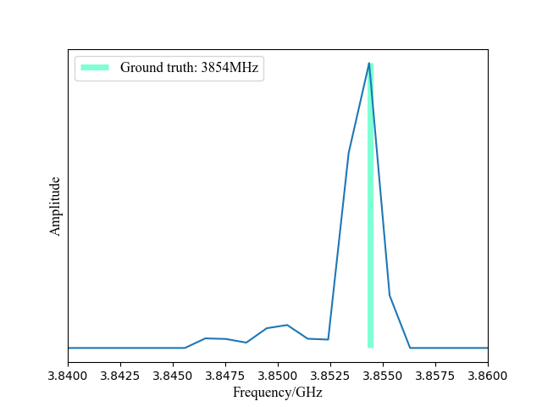
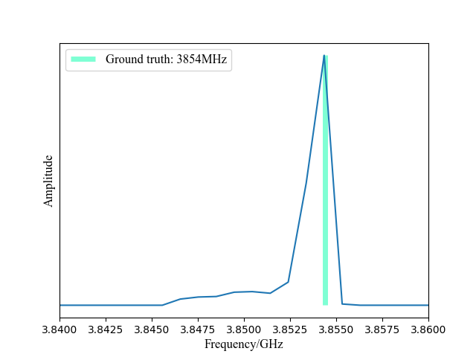
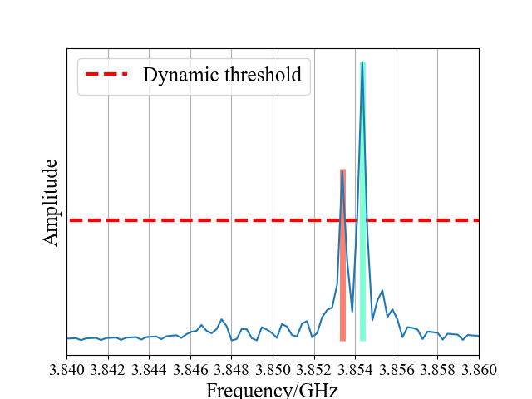
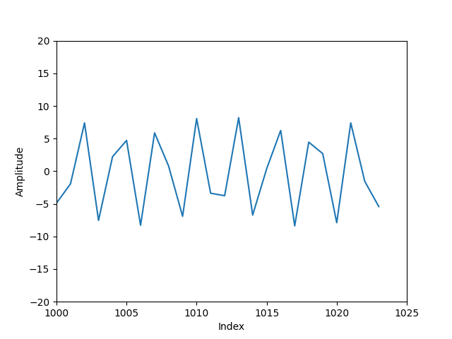
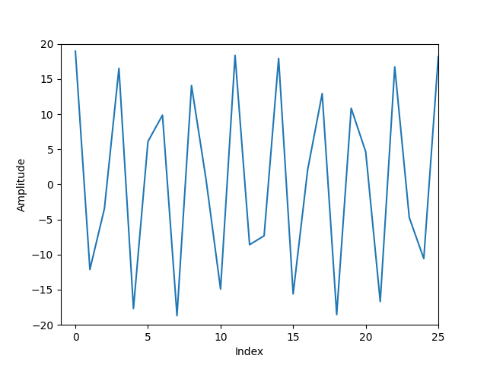
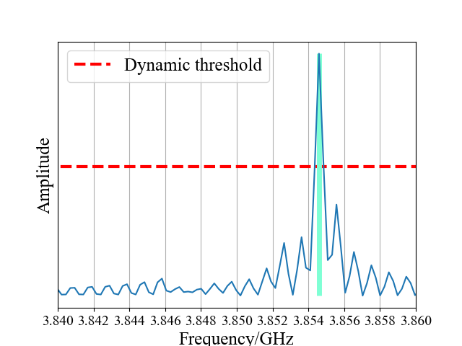
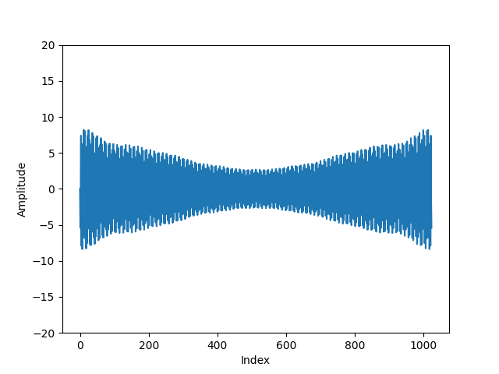
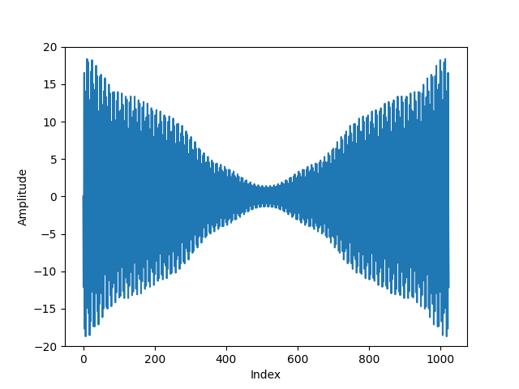
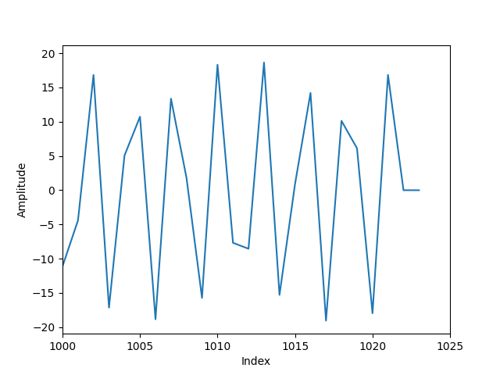
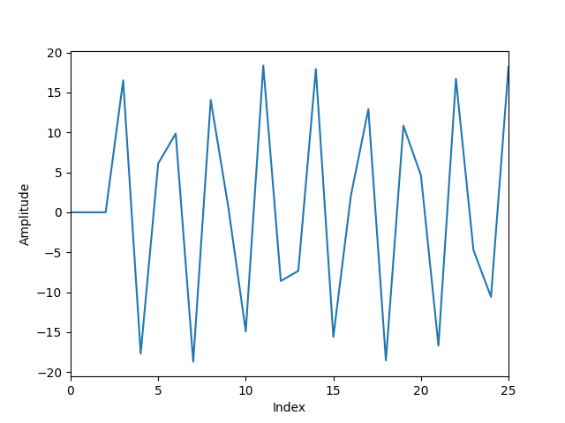
Low resolution-CIR concatenation
Discontinuity
Spectral leakage
CFRs with low resolution
Splicing
IFFT
Zoom
CIRs
Notes:
The other limitation is low spectral resolution. To address this limitation, we try to \ concatenate several successive CIRs. The \ discontinuity in the time domain will lead to spectral leakage. We perform \ normalization and splicing and finally get a fine-grained spectrum

Slide 24
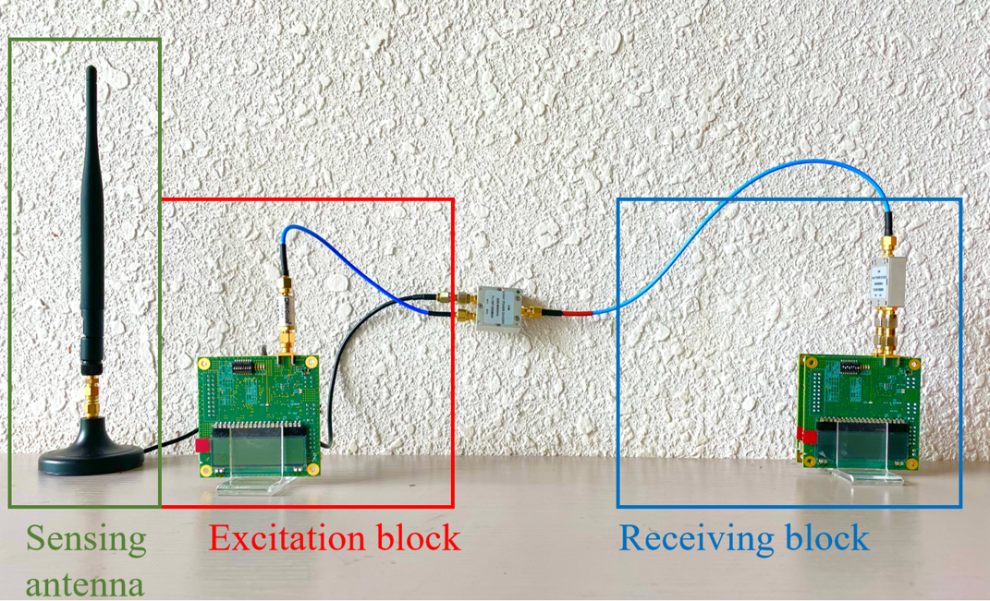
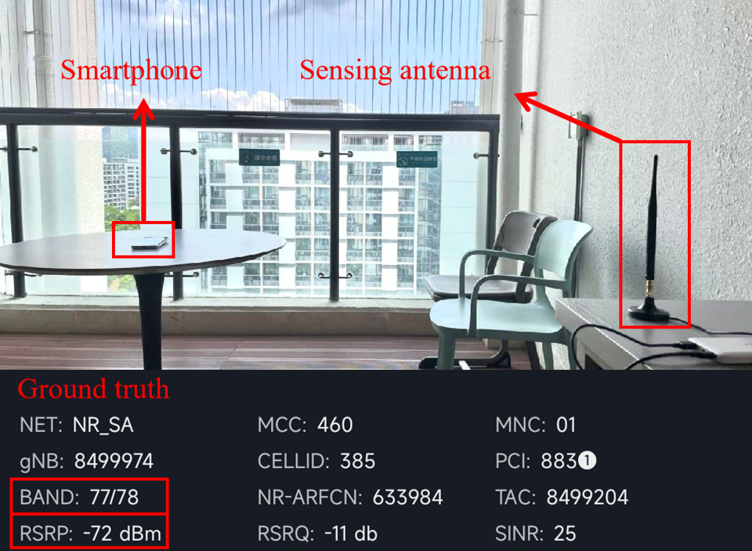
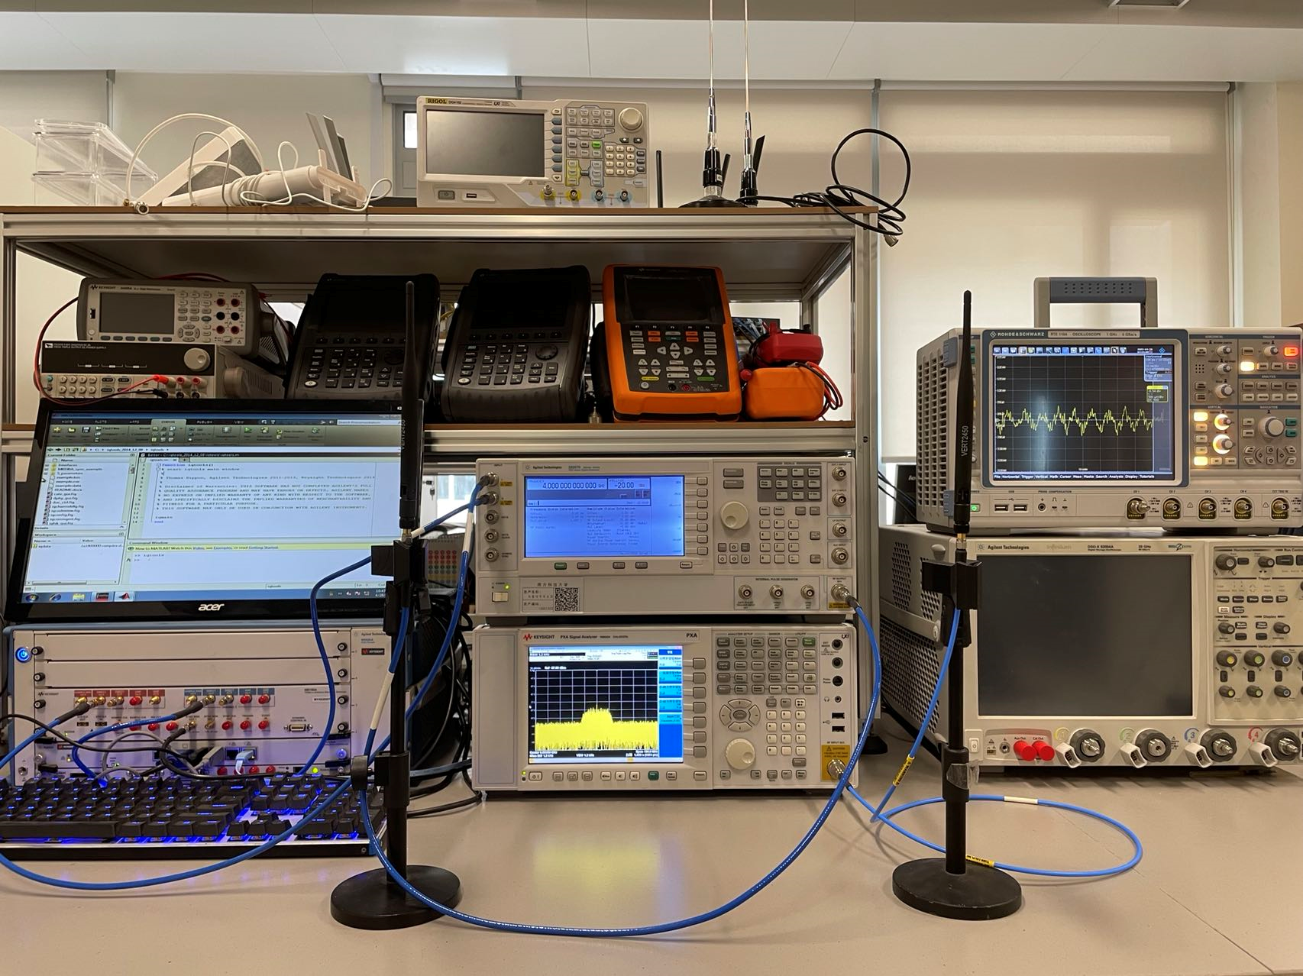
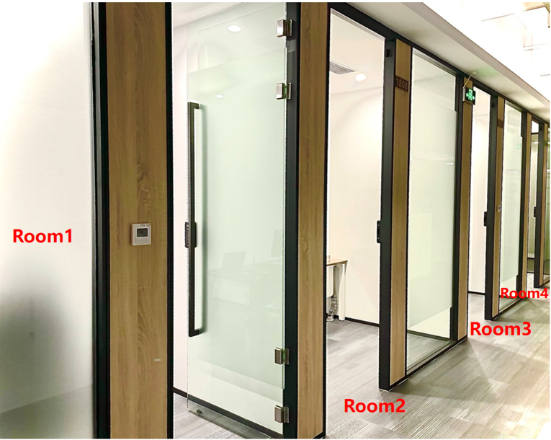
Evaluation - Implementation
WISE prototype
5G signal testing
Complex environment
Testbed
Notes:
This is the WISE prototype, we test WISE’s ability to detect wireless signals (including 5G), and evaluate its performance in complex environment.

Slide 25
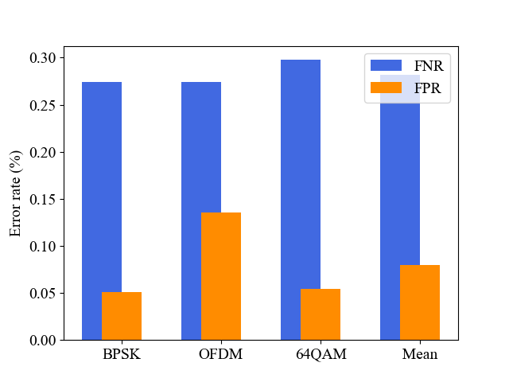
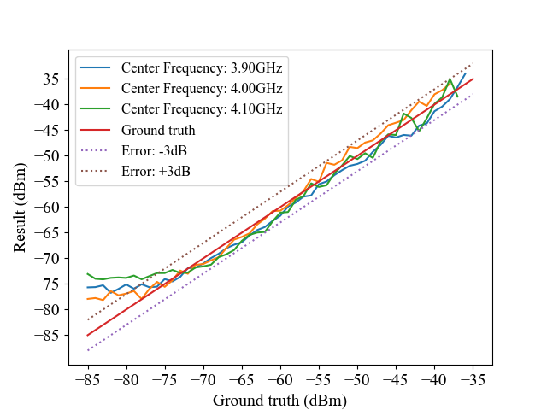
Evaluation - Comprehensive Performance
Error rate (FNR+FNR) =0.35%
Power estimation error<3dB
Notes:
Here are some results, we can see that the Error rate is only 0.35%. The power estimation error is less than 3dB

Slide 26
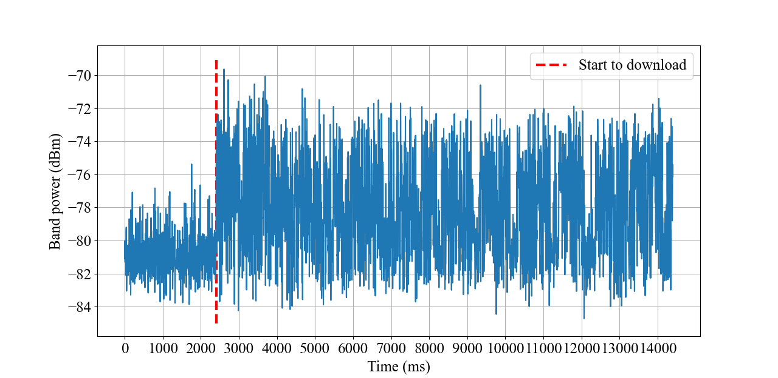
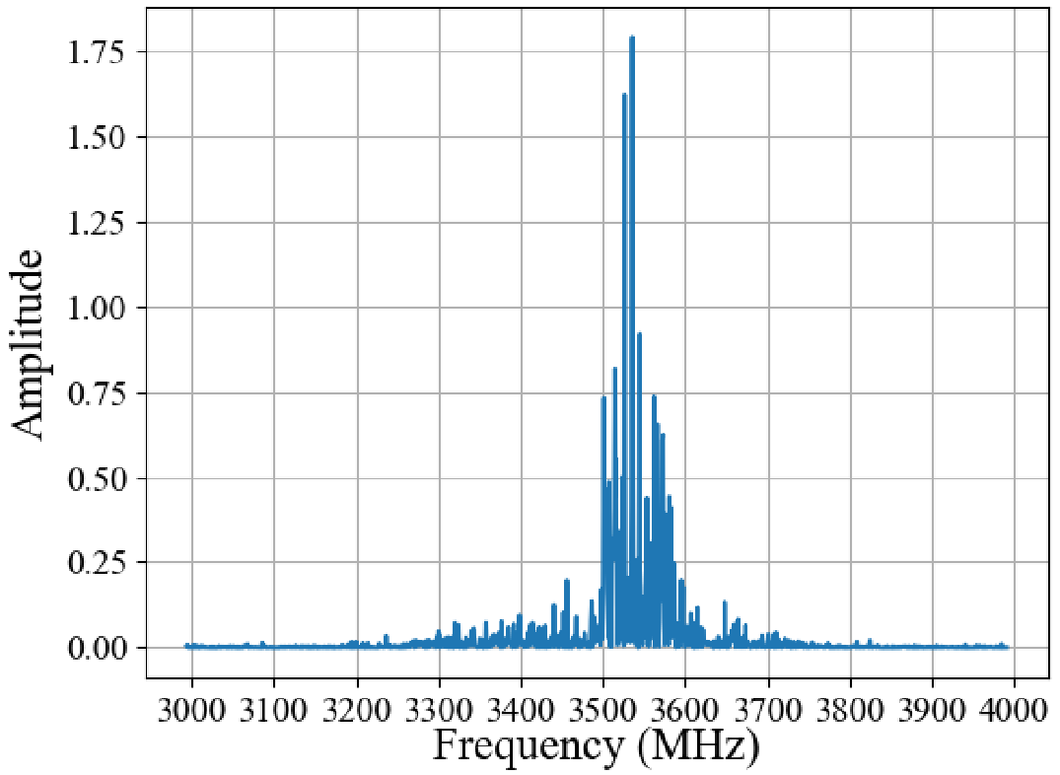
Evaluation - 5G Signal Detection
Spectrum of 5G signal
Monitoring 5G signal energy during downloading
Notes:
WISE can also detect 5g signal and could be used to monitor 5G NR bands

Slide 27
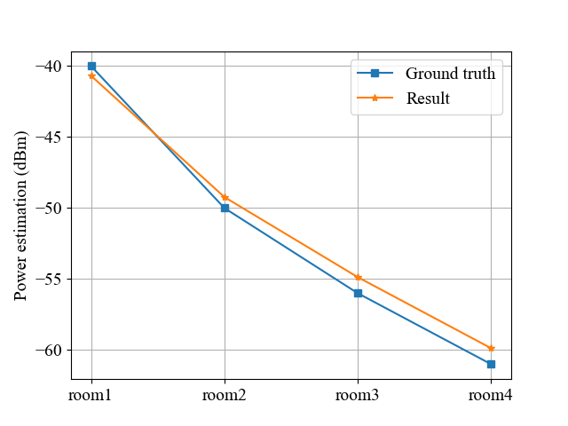
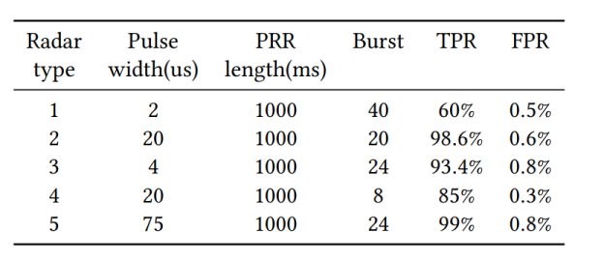
Evaluation - Robustness
Radar signal detection
Stable estimation in complex environment
Notes:
WISE can detect radar signals, and can also work in complex environments

Slide 28
Conclusion
We demonstrate the spectrum sensing capability of UWB chips, which provide a new direction to build cheap and wideband spectrum sensors.
We design WISE, a low-cost spectrum sensor that supports up to 900MHz bandwidth with high accuracy, good sensitivity, and wide dynamic range.
WISE can also detect fleeting radar signals and has good ability to detect 5G signals. WISE can be widely deployed and used for city-level spectrum planning.
WISE can achieve good accuracy of 99.65% in busy channel detection. WISE can also estimate 5G signal power with error less than 3dB in a complex environment.
Notes:
In conclusion, we design WISE, a low-cost wideband spectrum sensor that can achieve good accuracy of 99.65% in channel occupation detection and can also estimate 5G signal power with less than 3dB error in complex environments. More details can be found in our paper. Thank you all for your attention.

